Slide 1

The world of coffee
Project 3
Group 9
Notes:
Claudia
Thanks and welcome
The topic we choose to talk today is the World of Coffee

Slide 2
Team
Jeya Emmanuel
Chris Mai
Dat Nguyen
Claudia Sandoval
Notes:
Claudia
But first, let me introduce the team members who developed this project …

Slide 3
Agenda
Topic and background
01
Plan and Design
02
Process
03
Draft Demo
04
Claudia
JEYA
DAT
CHRIS
Notes:
Claudia
And the topics we are going to cover in our presentation

Slide 4
01 TOPIC & BACKGROUND
TOPIC BRIEF
Topic chosen: Worldwide coffee market including
Producers
Exports
Imports
Consumption
Data Exploration
The group wanted to investigate if coffee consumption in Australia was within the top 10 heavy consumers countries
As Australia is not a major coffee producer country, one way of measurement was to determine the imports / exports of coffee beans and the general consumption of coffee.
Historical and current databases were found in:
International Coffee Organisation: https://www.ico.org/
USDA Foreign Agricultural Service: https://www.fas.usda.gov/data/coffee-world-markets-and-trade
Statista: https://www-statista-com.eu1.proxy.openathens.net/topics/4615/coffee-market-in-australia/#dossierKeyfigures
Constrains: coffee consumption as presented needs to be considered as a generic measurement, the group did not research consumption based on type of coffee due to time limitations.
Notes:
Claudia
As I mentioned before, the topic we choose to investigate is the Worldwide coffee market, including
Main producers’ countries
Major coffee exporters and importers
How the consumption is distributed around the world
The hypothesis we wanted to demonstrate was
if Australia’s coffee consumption is within the top 10 heavy consumers countries?
Background:
We know that a strong coffee culture has been developing in Australia since the last decade and considering that Australia is not a major coffee producer country, our parameters for measurement was to determine the imports / exports of coffee beans and the general consumption of coffee.
Historical can current datasets were found in these website – which are mostly trade cooperatives.
We found some constrains as well, the consumption presented here is based on the consumption of the two most popular coffee varieties: Arabica and Robusta, which represents around 60% of the coffee production. There are more than 100 coffee species, such as: organic, green, soluble, decaffeinated, etc. But they have not been considered in this analysis.
And now, I will pass it on to JEIA who will talk about how we planned and designed our project.

Slide 5
02 Plan & design
PLAN
From the specific requirements for the Project, the team choose to work on a dashboard page with different charts that updates from the same dataset.
Data Munging techniques
Data Discovering: exploring dataset to know get acquainted with the information and defining the best approach for the analytic exploration.
Data Exploration: Refining raw data using Python (Pandas) to standardise the data, ensuring that all inconsistencies are addressed (null values / duplicated information)
Data Transformation: Once the raw data content and structure was established, it was transformed into a new data frame for downstream process.
Notes:
Jeya
As per the specific requirement of the project we chose to work on a dashboard page with interactive visualizations with charts that updates from the same dataset. We sourced several datasets which had data about Production, Export, Import and Consumption. We decided to work on the most recent dataset that has information about all 4 of the topics we chose. The dataset we chose was from the year 2017 to 2022 with a projection for 2023 as well. We went through the dataset as a team to identify what cleanup processes and formatting is required to address inconsistencies and remove null and duplicated information. We made a rough draft for the clean up process in excel and used Python(Pandas) to complete the cleanup process and got it ready for the next process.

Slide 6
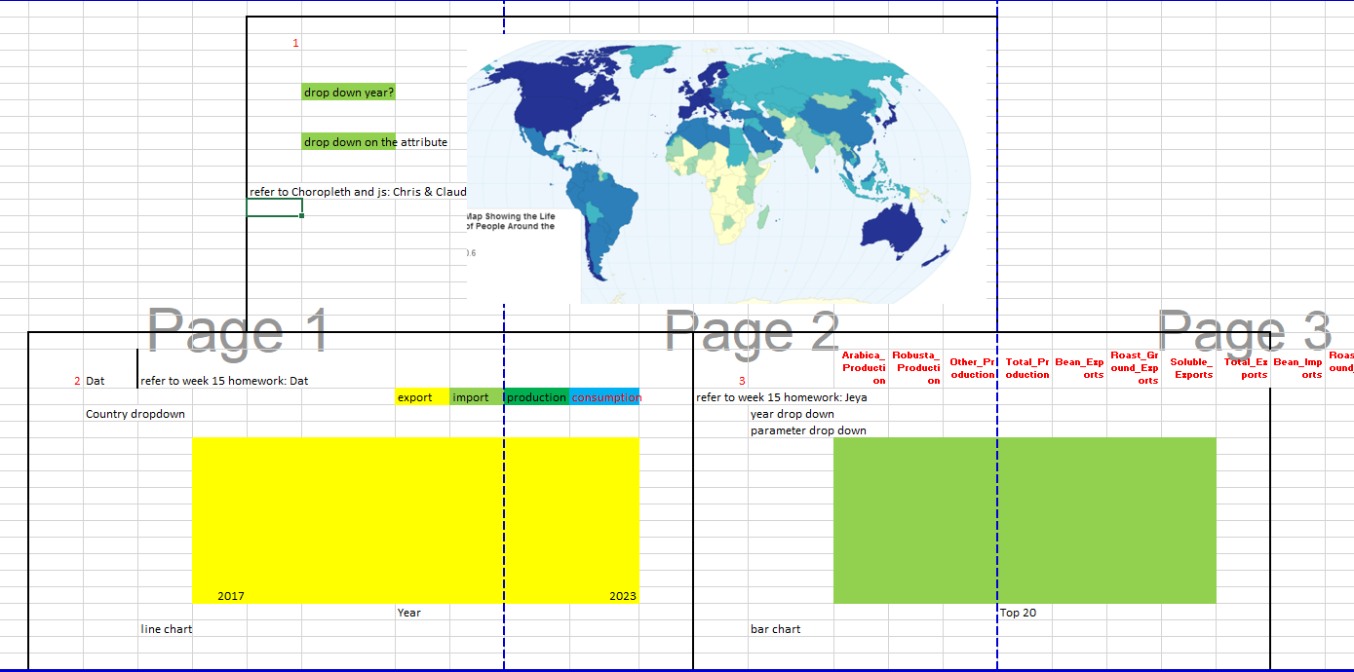
02 Plan & design
DESIGN
Data Enrichment: What else could be added? Which visualisation could be used to show the data in depth?
Data Validation: verify that we caught all the data quality and consistency issues. The team discovered, for example, that data for Europe were merged together as a region, not differentiated by countries.
Notes:
Jeya
This image shows the draft charts we decided to produce from the cleaned data
3 interactive visualizations One showing a world map with the countries and a drop-down list showing the different filters A bar chart with the top 10 countries based on the year and the attributes chosen A line chart filtered by country and for each country filtered by Production, consumption, Imports and Exports from 2017 to 2023
We decided to use plotly for the world map and bar chart
We use line chart from charts.js(HTML5 based JavaScript charts

Slide 7


Key to Success
03 Data Validation
05 Visualizations
04 Databases
01 Data Cleaning
02 Data Transformation
06 Deployment
Notes:
DAT
These are the process steps we take to prepare the output

Slide 8
03. PROCESS
1. Data Exploration
Data was found and selected only the most aligned with the brief. Information was downloaded in csv files.
2. Database design
3. Data Transformation
Data cleaning included deleting and adding columns, and properly structure the information. Pandas were used to complete this tasks. A dataset in csv with all the information needed were produced and upload to the repo.
Group decision on the structure of the output based on data information.
4. Database creation
A SQLlite database was created through sqlite3 to load the cleaned data, and get ready for data query through the API Flask.
Apps used: Python, Pandas, Numpy, sqlite3
Notes:
DAT

Slide 9
03. PROCESS (continue)
5. API Flask App
7. Local Deployment
Deployed the app locally. Checking if the correct data loaded and charts responded according to selected options.
A HTML file was created to align a the defined layout using Bootstrap.
A JS script was built to request data from API Flask App. The user options were loaded dynamically using D3
8. Data Migration
Migrate the data to Postgres database for production deployment on Heroku.
6. Data Visualization
Development of API Flask app to query and extract information from the SQLite database, and return the data in Json format.
Interactive Charts were created using ChartJS and Plotly.
Apps used: Flask-SQLAlchemy, python, html, Postgres, JS Library: ChartJS, Plotly, D3, Bootstrap
Notes:
DAT

Slide 10
03. PROCESS (continue)
9. Data Validation
Followed Heroku documentations to restructure apps folder, added Heroku dependencies and tested Locally.
Heroku Deployment
10. Heroku Dependencies
Validated the Flask app and JS app were still working correctly locally.
https://coffee-worldwide.herokuapp.com/
Apps used: Flask-SQLAlchemy, python, html, Postgres, Heroku, Github, JS Library: ChartJS, Plotly, D3
Notes:
DAT

Slide 11

04 DRAFT DEMO
https://coffee-worldwide.herokuapp.com/
Notes:
CHRIS
Thanks Dat!
Group 9 Heroku app:
https://coffee-worldwide.herokuapp.com/
**Share on slack for others to check out

Slide 12
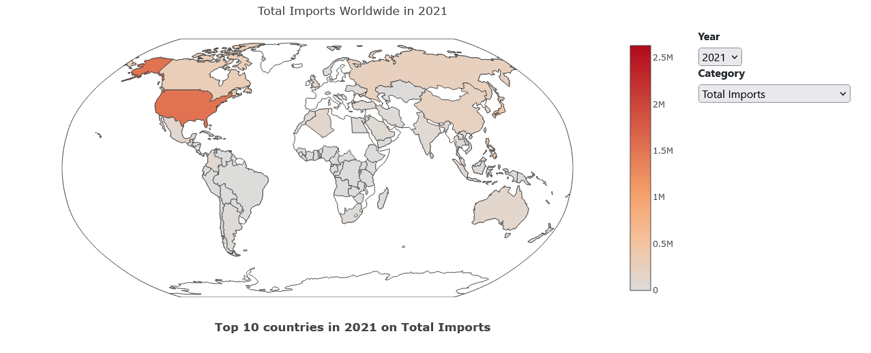
Choropleth MAP
Notes:
CHRIS
Map – inspired by Choropleth, median house prices exercise
by years from 2017-2023* (2023 are projections for that year)
Categories – different properties from our data (**show attributes)

Slide 13
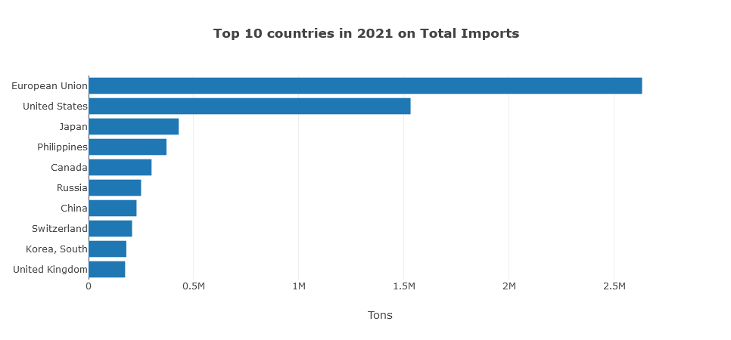
Plotly chart
Notes:
Chris
Render Top 10 countries for different attributes – i.e. plotly, bully button homework
Findings – Brazil – top producer and consumer as of 2022
- Ethiopia also top producer and consumer – fun fact: coffee originated in Ethiopia
- Australia not in top 10 consumers – our population a factor??

Slide 14
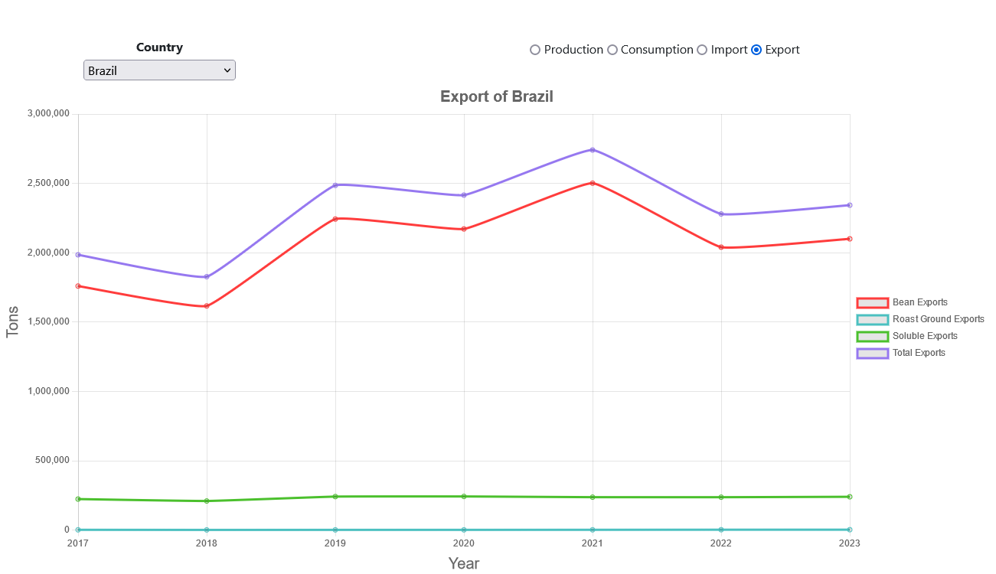
Js library
Notes:
CHRIS
Chart js library, breaks down data by Country **show Brazil as example
Findings for Aus
– No production market
- More consumers – high bean import -> not only big coffee lovers but also coffee connoisseurs

Slide 15


Thank You
Questions?
Notes:
That concludes our presentation on the World of Coffee
Let us know what you think about our app
We will take any questions
(All Team)

